Slide 1
AuE 835: Automotive Electronics
Project 1: AUTONOMOUS VEHICLE
Project 2: AUTONOMOUS BOAT
Group 17
Akil Patheria
Kaushik Tilve
Sanket Bachuwar
Yong He

Slide 2
CONTENTS
• Distance Sensing • Control of Autonomous Vehicle • Control of Autonomous Boat • Differences and Challenges

Slide 3
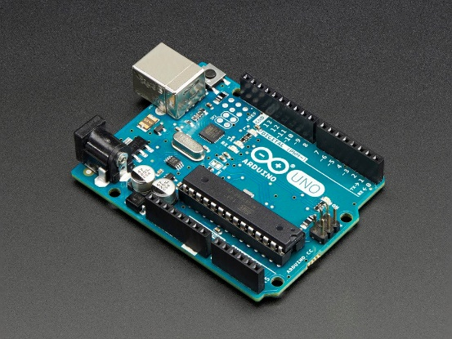
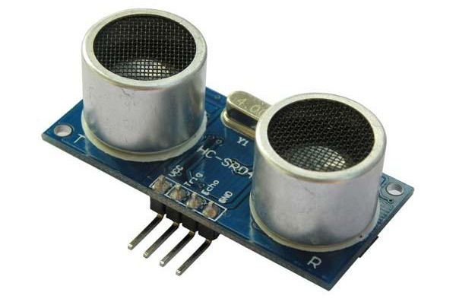
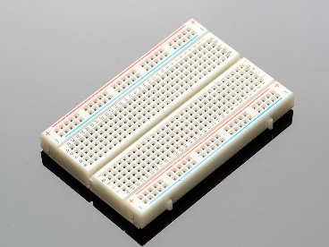
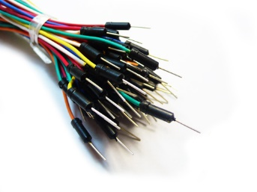

Hardware and Resources
COMMON TOOLS:
Prototyping board
Distance Sensors
Solderless Breadboard
Jumper cables
Development environment

Slide 4
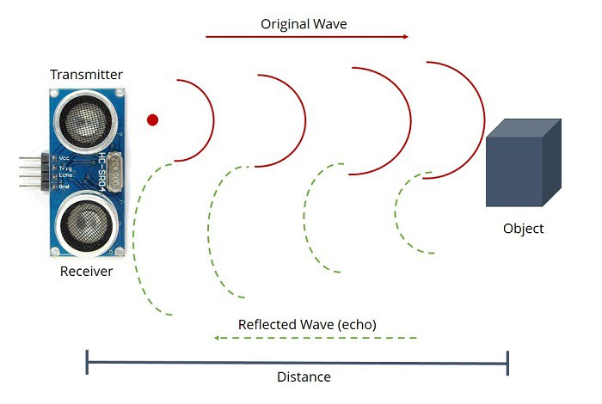
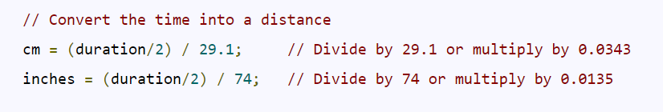
1.1 Distance Sensing
Aim: Obtain accurate distances using • Proper calibration function
• Filtering Algorithm
Principle: HC-SR04 calculates time, not distance!

Slide 5
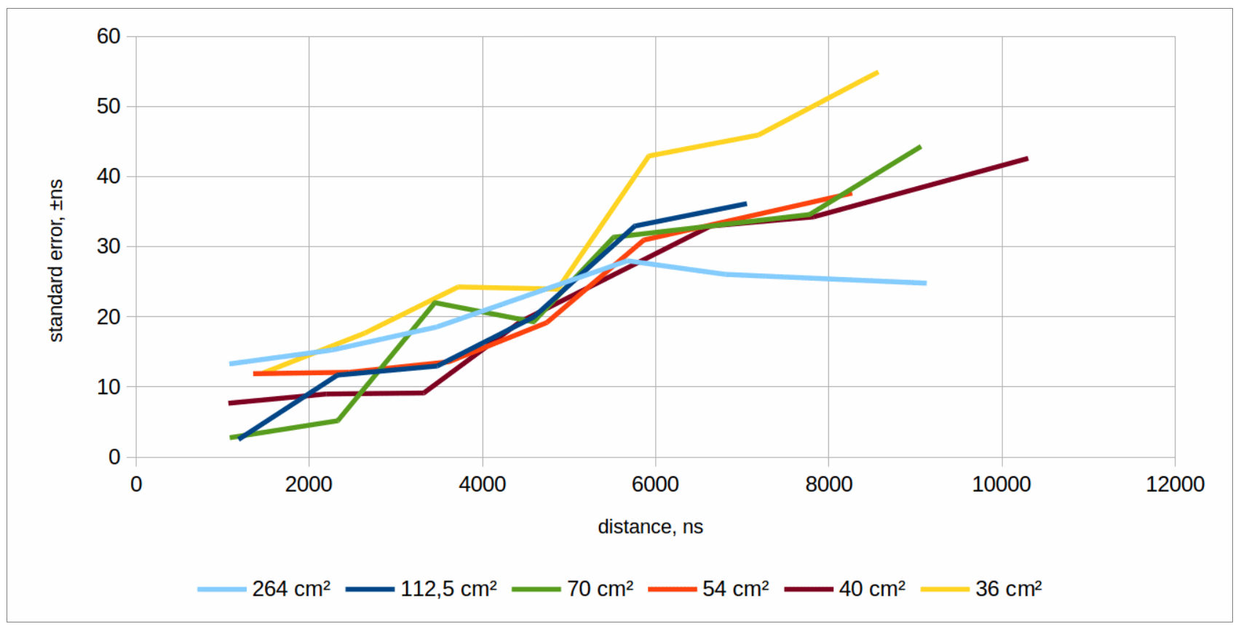
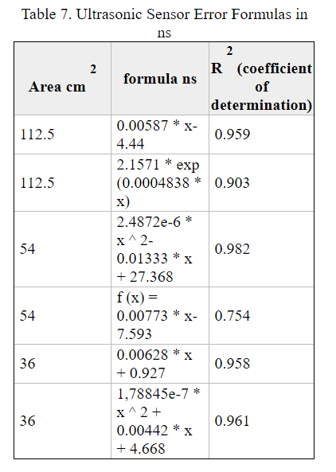
Calibration Method
The filtered data was calibrated using piecewise fitting for discrete range brackets
The linear curve was of the form “Y = a*X + b”

Slide 6
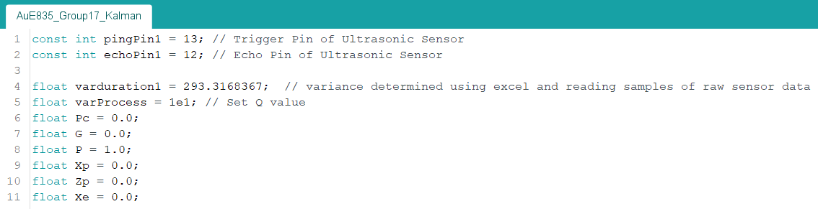
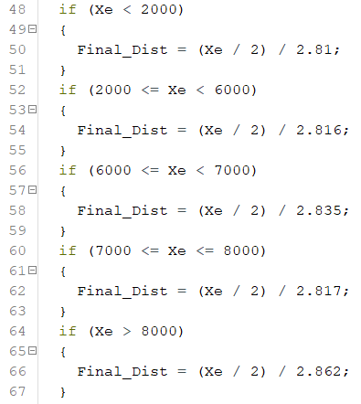
Filtered Data
Raw Data
Filtered Output

Slide 7
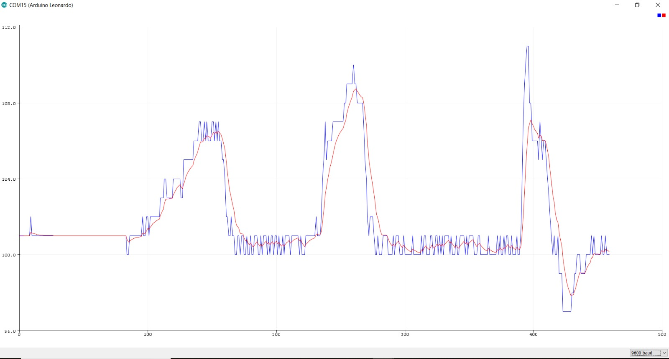
Filtered Data
Raw Data
Filtered Output

Slide 8
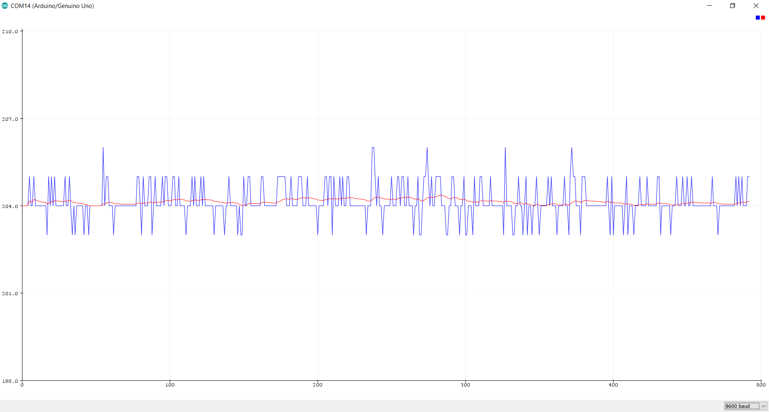
Filtered Data
Raw Data
Filtered Output

